Slide 1

CAPSTONE PROJECT - 1
BY –
Sahil Singh 0817659
Jarmandeep Singh 0821567
Jasreet Kaur 0817638

Slide 2

INTRODUCTION
The data are supplied by state education agency officials and include basic directory and contact information for schools and school districts, as well as characteristics about student demographics, number of teachers, school grade span, and various other administrative conditions.
A selection of administrative attributes for public elementary and secondary schools from the 2020-2021 school year applied to point locations created by the National Center for Education Statistics' (NCES) Education Demographic and Geographic Estimates (EDGE) program.

Slide 3

PURPOSE
The National Center for Education Statistics (NCES) Education Demographic and Geographic Estimates (EDGE) program develops data resources and information to help data users investigate the social and spatial context of education. School point locations (latitude/longitude values) are a key component of the NCES data collection. These data are needed to address a variety of spatially-oriented tasks and research questions.
They provide information needed to construct NCES school-based surveys; they provide indicators needed to help determine program eligibility; and they provide the foundation for determining geographic associations with other types of entities.

Slide 4
METHODOLOGY
Data Preprocessing
Exploratory Data Analysis
Discriptive Visualisation (Tablue)
Conclusion

Slide 5
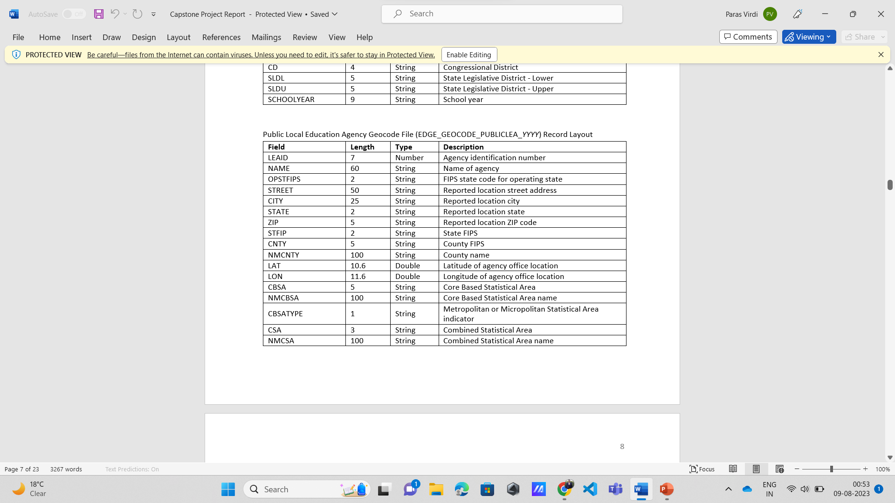
A SAMPLE OF OUR DATA

Slide 6

DATA PREPROCESSING
Importing Data (Using Pandas) -
Pandas is an open-source Python library that provides easy-to-use data structures and data analysis tools. It is widely used for data manipulation, analysis, and cleaning in the field of data science.
Pandas allows users to work with two primary data structures: Series and DataFrame.

Slide 7

SERIES AND DATAFRAME
Series: A one-dimensional array-like data structure that can hold various types of data (e.g., numbers, strings, dates). Each element in the Series has an associated index, which can be customized or automatically generated.
DataFrame: A two-dimensional tabular data structure, like a spreadsheet or a SQL table, that consists of rows and columns. It allows users to store and manipulate data in a format that resembles a relational database table.
However, the data set that has been used here has more than 1 million entries. To deal with such a big data Pandas is used.

Slide 8
Dealing with Duplicates and Null Values
The dataset does not have any duplicate values. So, we move to the next step that is removing the Null values.

Slide 9
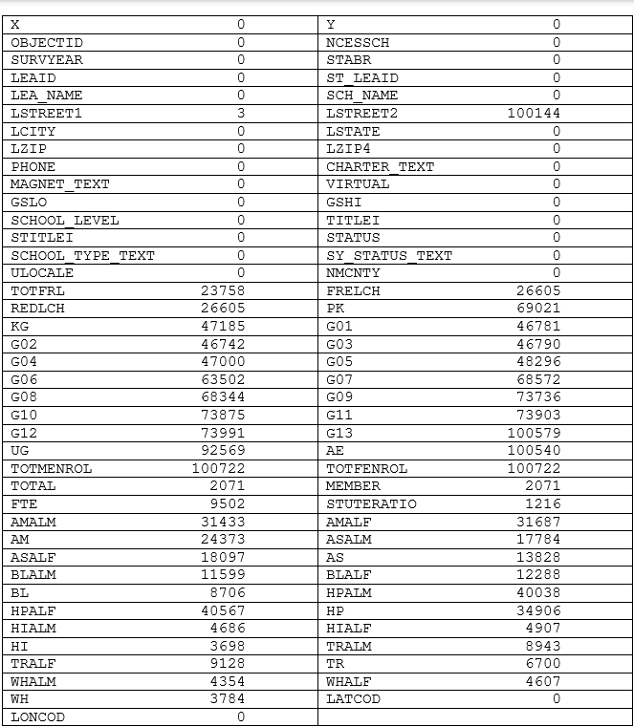
From the table it can be seen that attributes ‘LSTREET2’, ‘TOTMENROL’, ‘G13’, ‘AE’, ‘TOTFENROL’ has more than 90% of its values as 0. So, these attributes can be deleted. Moreover, given attributes ‘TOTFRL', 'FRELCH' ,'REDLCH' ,'X', 'Y', 'OBJECTID', 'NCESSCH', 'PHONE' are of no use so these are deleted as well.

Slide 10

CONTD..
Grade values can be zero because number of students in different type of schools in particular class could be zero. For example, primary school won’t have any kindergarten student and vise versa. Therefore, It is acceptable if the NAN is replaced with 0. Moreover, there can be zero number of students from different race in some schools. so it can be Zero as well. So, wherever there is any NAN in given attributes 'KG' ,'G01', 'G02', 'G03', 'G04', 'G05', 'G06', 'G07', 'G08', 'G09', 'G10', 'G11', 'G12', 'G13', 'UG', 'AE', 'PK', 'AMALM', 'AMALF', 'AM', 'ASALM', 'ASALF', 'AS', 'BLALM', 'BLALF', 'BL', 'HPALM', 'HPALF', 'HP', 'HIALM', 'HIALF', 'HI', 'TRALM', 'TRALF', 'TR', 'WHALM', 'WHALF', 'WH' is replaced to 0.

Slide 11
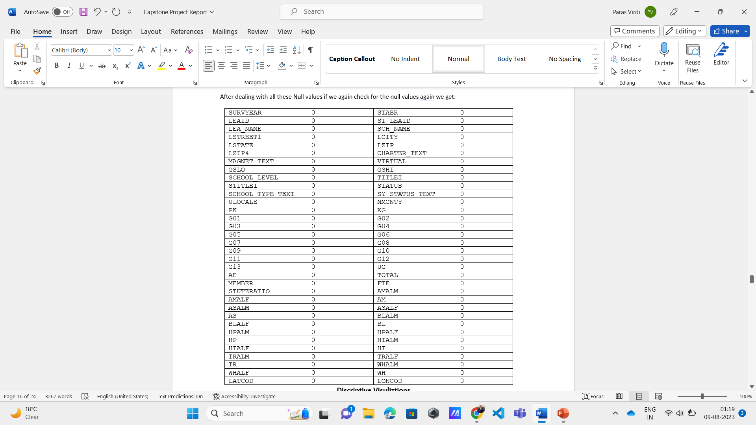
After dealing with all these Null values if we again check for the null values again, we get:

Slide 12
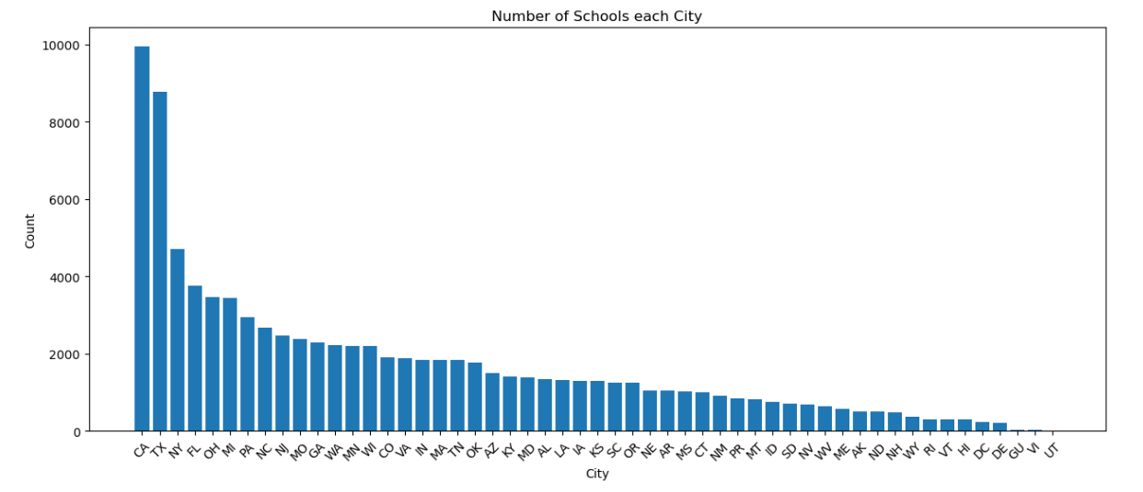
Descriptive Visualizations The given Graph represents the number of schools present in different cities of United States. It is noticeable that in year 2020 – 2021 California has the maximum number of schools with the count of 10000. Followed by Texas with 8453 number of schools.

Slide 13
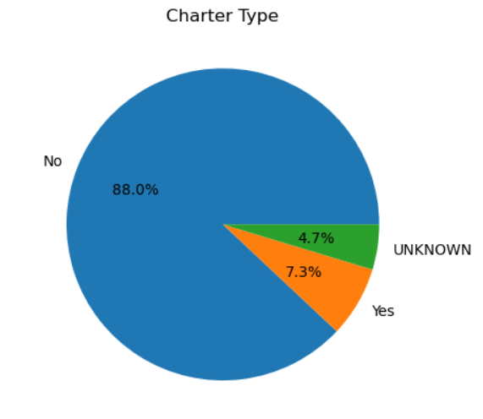
The Pie chart here shows what percentage of the schools is charity and not charity. 88.0% of the schools are not charity and 7.3% are the charity one’s. However, 4.7% of the schools are unknown that they belong to which category.

Slide 14
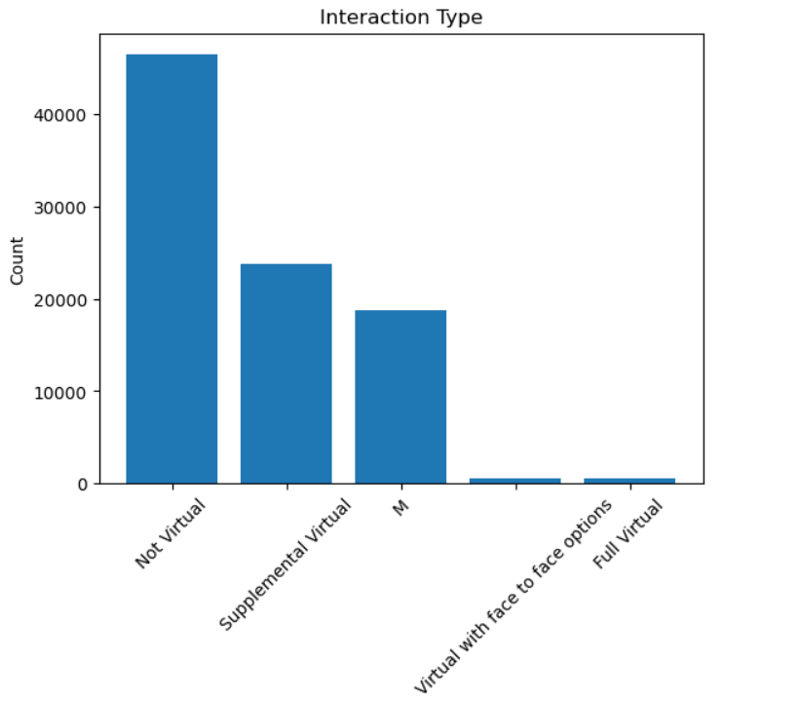
Most of the schools took in person classes. There are some schools that offers Supplemental Virtual Classes. Which means the school take non virtual classes but there are some supplementary classes Which are provided virtually. The type Virtual with face-to-face options and Full Virtual schools are very low in count when compared to non virtual schools.

Slide 15
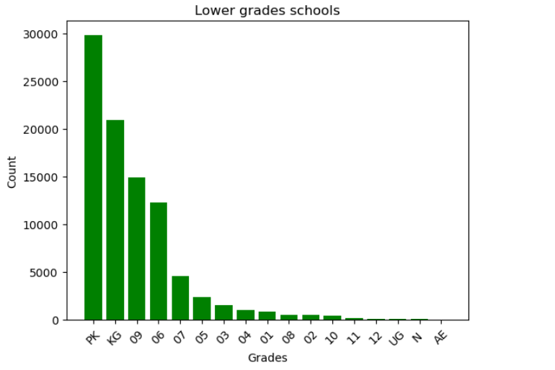
There are almost 30,000 schools with Prekindergarten schools.

Slide 16
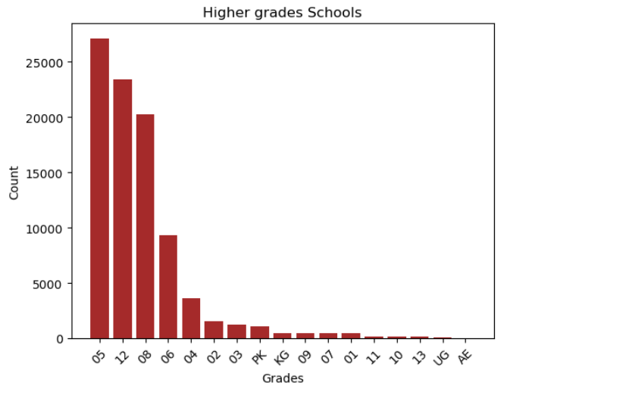
Grade 5 classes are offered with the maximum number of 29987

Slide 17
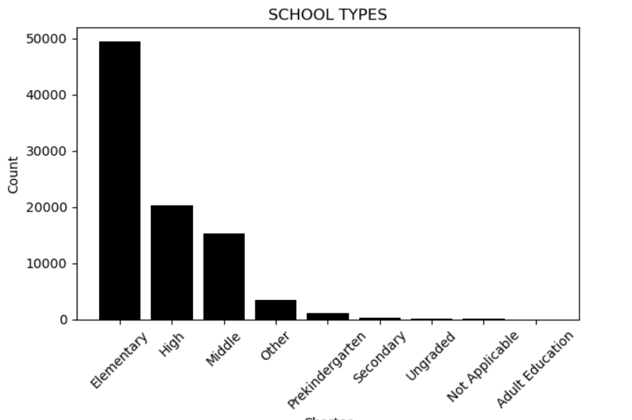
School types can be mentioned as for two categories.
For the level of school
For the type of education, it is offering.
1. The schools with the different levels and their count over the united state can be seen from the given bar plot. From the plot we can see that the maximum number of schools that are there in united state are Elementary Schools, followed by High schools and then Middle schools. Moreover, there are other school types with a small number.

Slide 18
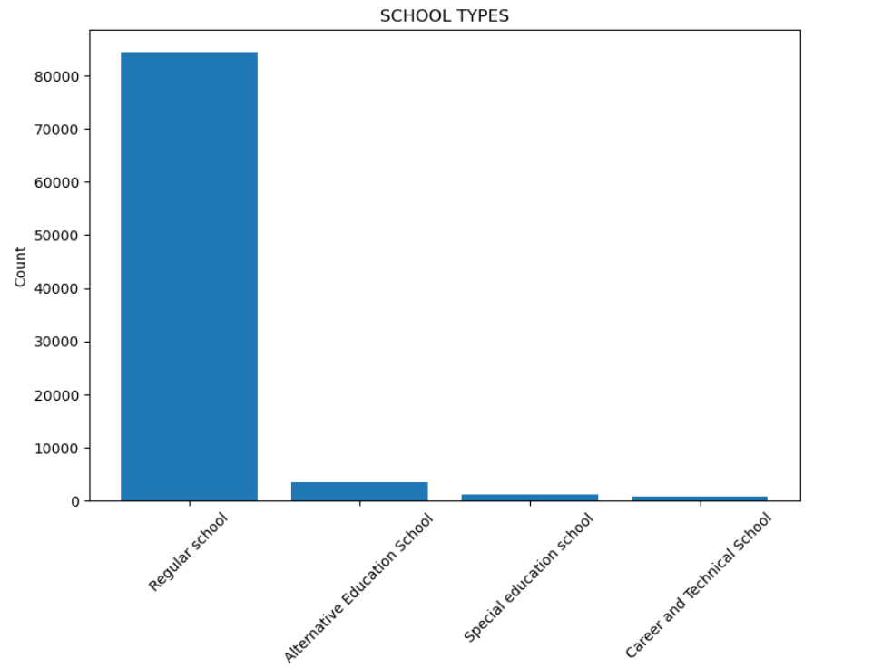
2. Most of the schools are regular schools. In comparison with the regular schools, alternative education schools, Special education Schools, Careers and technical schools are low in number.

Slide 19
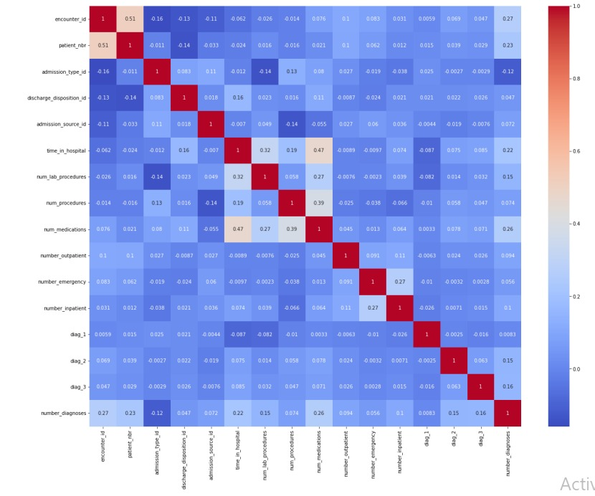
Correlation A correlation heatmap is a graphical representation used to visualize the correlation between different variables in a dataset.

Slide 20

Data types from object to categorical
Some column has object datatypes so basically, we change their datatypes to categorical to make our dataset accurate. We change the datatypes of Level column due to responsible for we have three attributes in under this column: national, county and state.
Min-Max Scaling:
It is a data normalization approach that scales data between 0 and 1. It is a simple technique to normalize data using Python’s min-max functions.
Normalization is only deal with numerical data, so I decided all category Variables.

Slide 21

Experimental Design
Cross validation:
A technique for testing efficiency of machine learning models are cross validation. For modeling, I implemented some model's validation techniques. As stated below:
Train and Test Split Approach: In this model, the entire data is randomly divided into training and test set. I divided the information into two parts (training and testing sets). The training set contains 80% of the records in the dataset whereas, the test set contains 20% of the dataset observation

Slide 22

KNeighborsClassifier
When given a new input data point, the KNN classifier identifies the k nearest data points (neighbors) to the input in the feature space. The class of the input data point is then determined by the majority class among these k neighbors. In other words, if most of the k neighbors belong to a particular class, the input data point is classified into that class.
The choice of the 'k' value is essential in KNN. A smaller 'k' might lead to noisy decisions, while a larger 'k' may cause the boundaries between classes to become too smooth. The optimal value of 'k' depends on the specific dataset and problem at hand and is often found through experimentation or cross-validation.

Slide 23

DecisionTreeClassifier
Decision trees can be prone to overfitting, where they memorize the training data and perform poorly on new, unseen data. To mitigate this, you can tune hyperparameters like max_depth, min_samples_split, or min_samples_leaf to control the size and complexity of the tree and improve its generalization ability.
The DecisionTreeClassifier is a powerful and interpretable classification algorithm, making it a popular choice for various machine learning tasks. However, in more complex scenarios, ensemble methods like Random Forests or Gradient Boosting might be preferred, as they can improve performance and reduce overfitting compared to individual decision trees.

Slide 24
References
Public School Characteristics 2020-21 - Catalog (data.gov)
Public School Characteristics 2020-21 - Original ISO-19139 metadata - Catalog
Public School Characteristics 2020-21 - ArcGIS Hub Dataset - Catalog
Public School Characteristics 2020-21 - ArcGIS GeoService - Catalog (data.gov)
Public School Characteristics 2020-21 - Public School Documentation - Catalog (data.gov)
Public School Characteristics 2020-21 - Public School District File - Catalog (data.gov)

